Slide 1
Object-oriented programming today. Practical (Part 3).

Slide 2
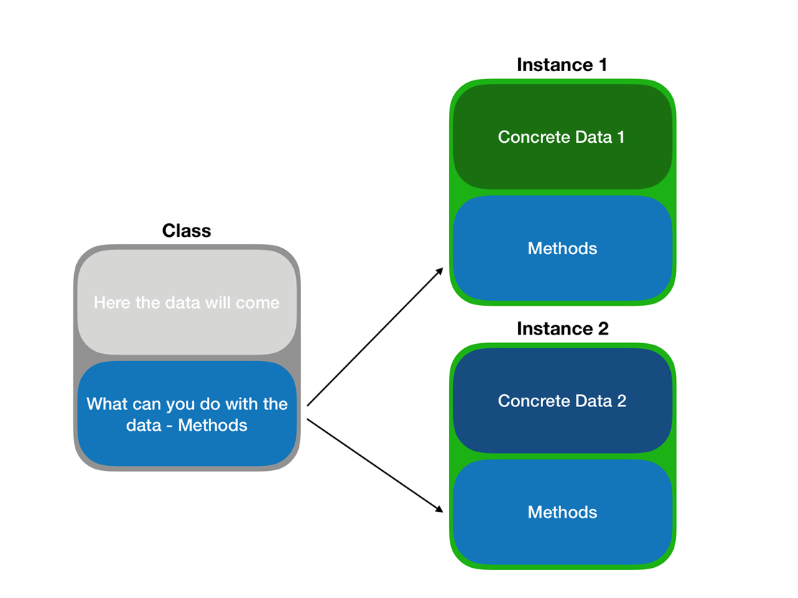
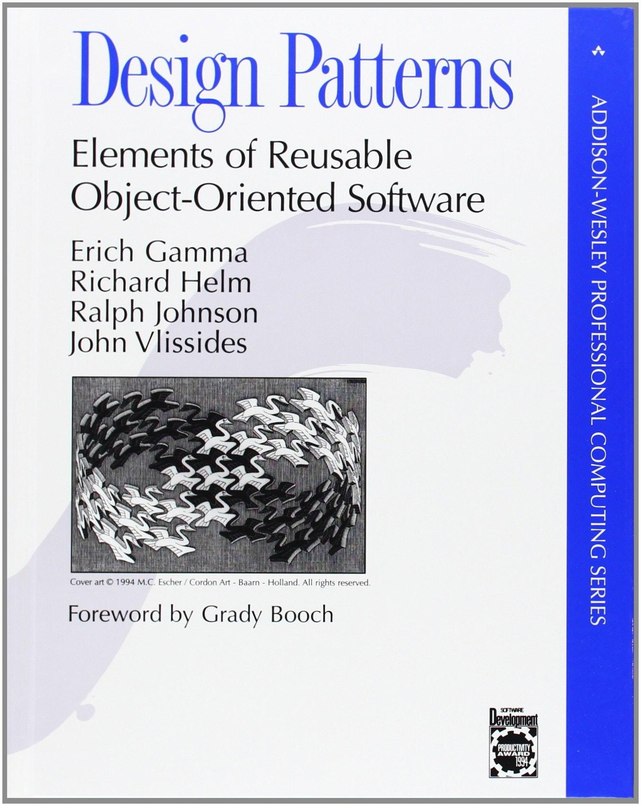
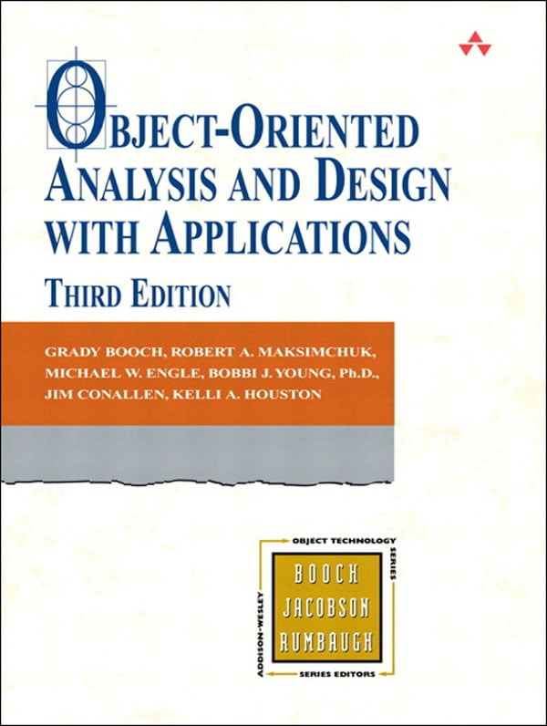
Short reminder of previous parts
Part 1 was mainly concerned with the evolution of object-oriented design
Part 2 was mostly about abstractions and anti-object patterns

Slide 3
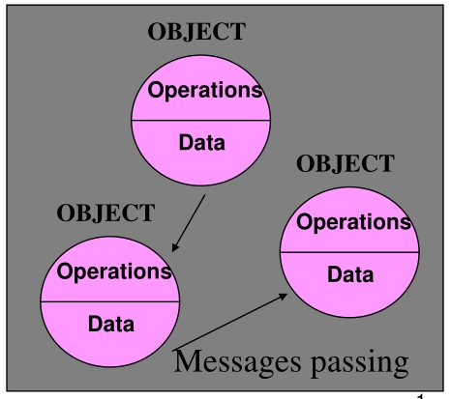
Short reminder of Part 1
OOP is an imperative approach
OOP in early days was about:
messaging
(local retention, protection, and hiding) of state-process
extreme late-binding of all things

Slide 4
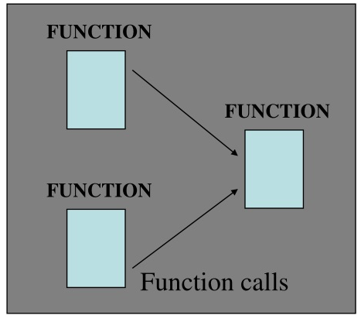
Short reminder of Part 2
If abstraction is not enough, further extensions of the project will run into architectural limitations
If the abstraction level is too high, it will lead to overengineering What we often call "objects" are just composite datasets with functions

Slide 5
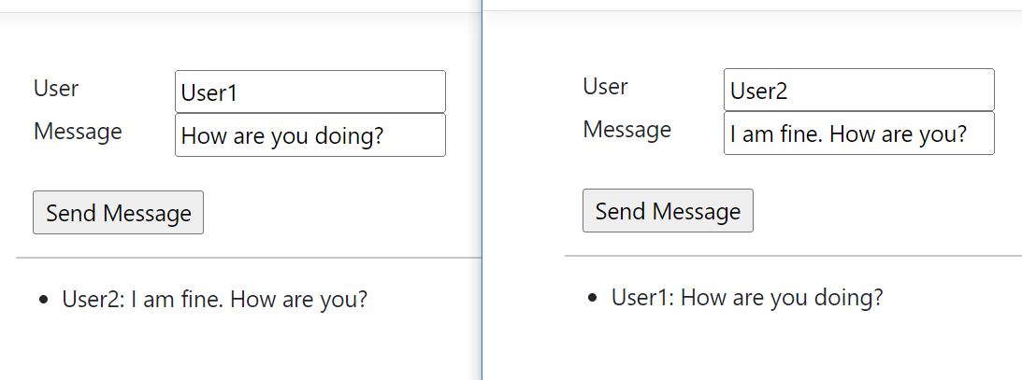
A Simple Chat Application project
We are not going to implement a user interface, network communication and message history storage. A console application will be enough.
UI is showed for clarification how it would be.

Slide 6

A Simple Chat Application requirements
User does not have authentication.
The user enters a name, a message for the chat and send it.
The user cannot change the name after sending first message.
The message will be available to all users in the chat, except the sender.
The message must contain the sender's identification.
If the user does not send a message within 10 minutes, he will leave the chat, and the name may be available for change.
Prove the correctness of the application using tests.

Slide 7

ChatGPT helped us
First attempt was made in TS
ChatGPT translated from TS to C#
We fixed discrepancies
And we started analysis…

Slide 8
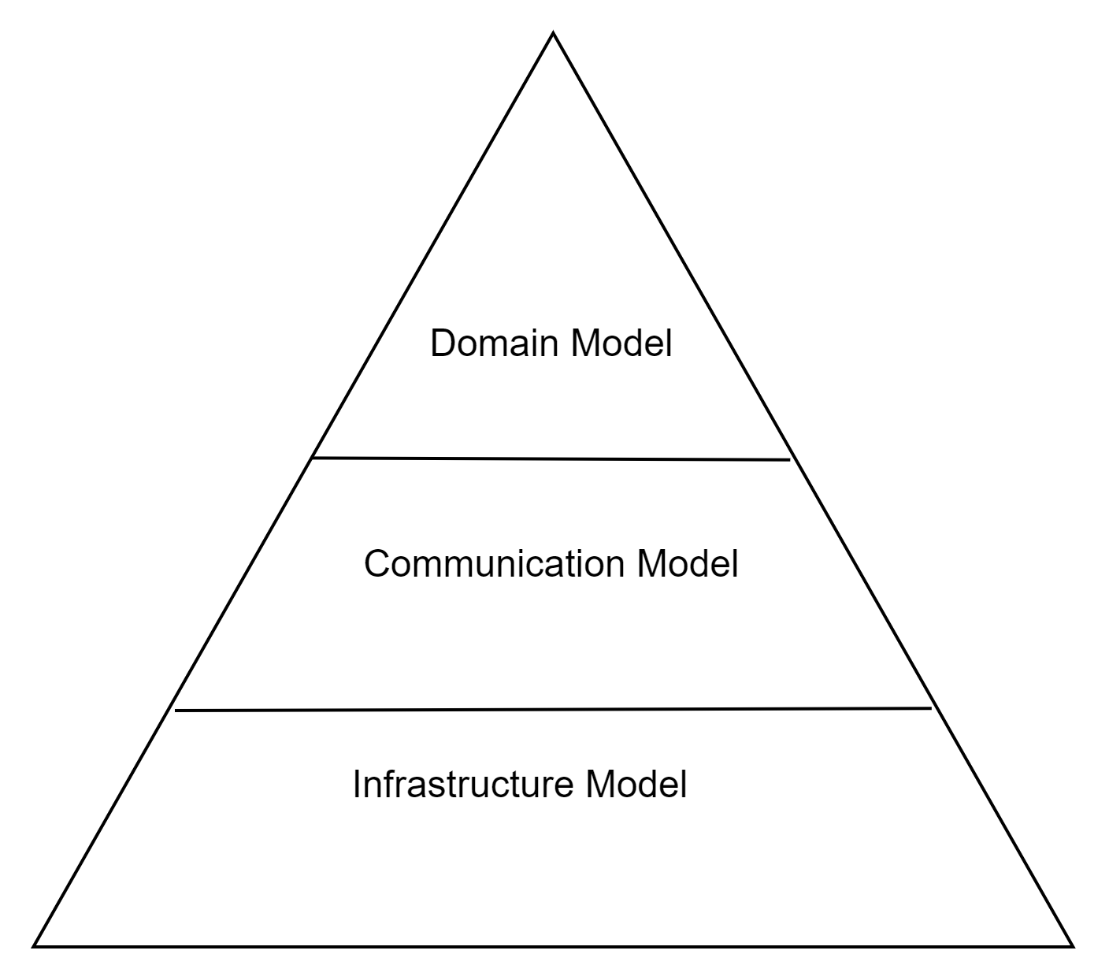
Implementation review
Top-Down vs Bottom-Up approach No clear domain model - lack of business entities - lack of communication between entities - interfaces & classes look like DTOs No clear communication/infrastructure model - no client model - no server model - no model of communication between client & server No proper separation between domain and communication models - everything is packaged in one assembly - suspicious namespacing Solution is based on concrete implementation No need to implement the communication layer at all
Notes:
Top-Down vs Bottom-Up approach – Server.ts, Server.cs | Client.ts, Server.cs
No clear domain model – Users.ts, Users.cs | Message.ts, Message.cs
No clear communication/infrastructure model – AbstractClient.cs | AbstractServer.cs | Server.ts, Server.cs | Client.ts, Server.cs
suspicious namespacing – walkthrough the all files in the project Solution is based on concrete implementation – AbstractServer.cs, Server.cs | AbstractClient.cs, Client.cs

Slide 9
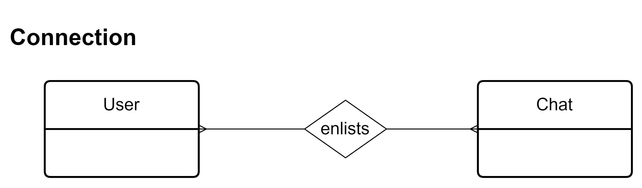
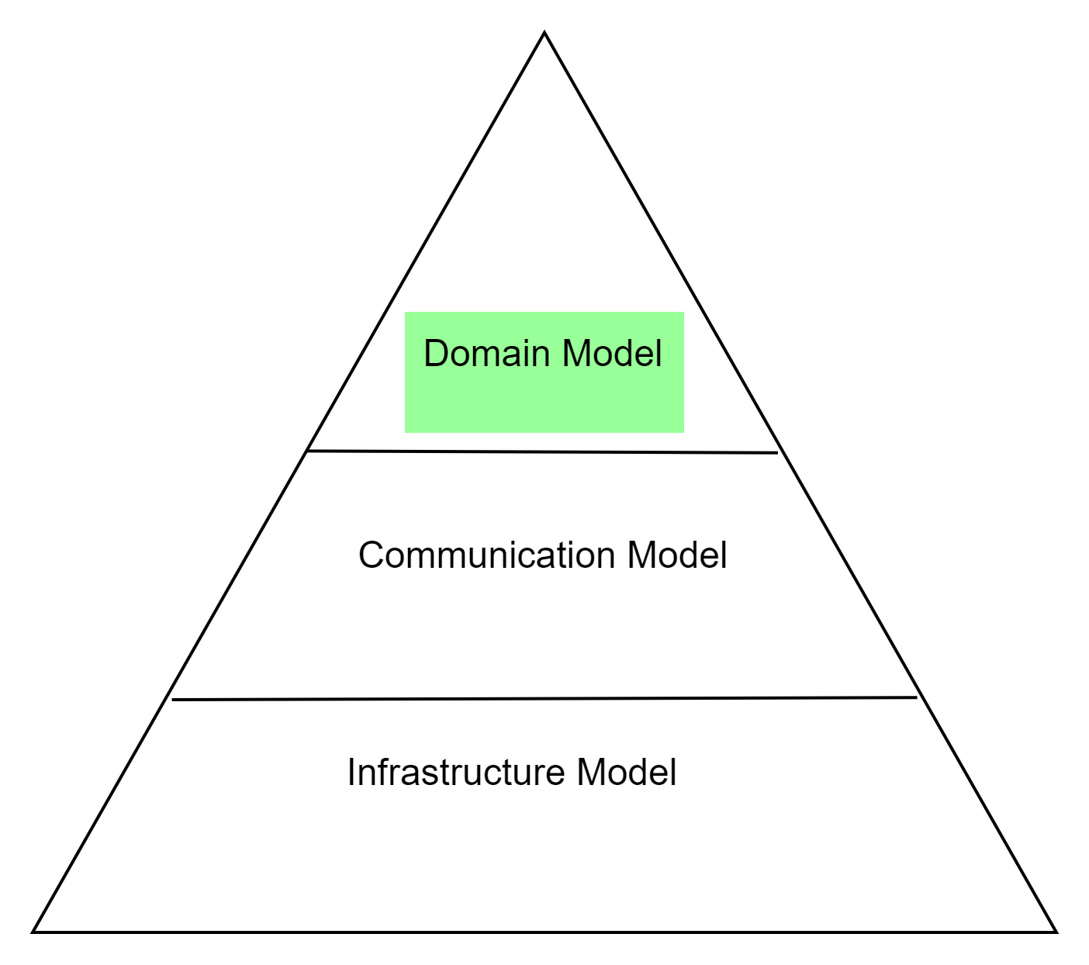
Domain Model Entities

Slide 10
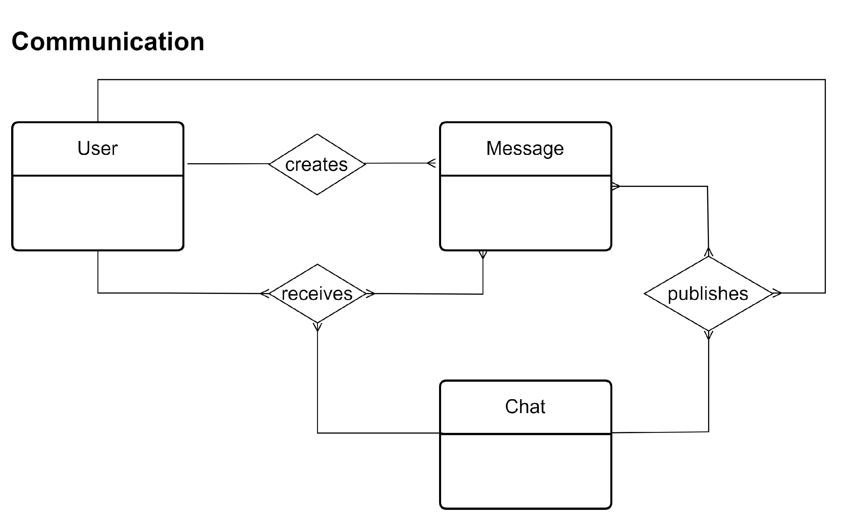
Domain Model Entities

Slide 11
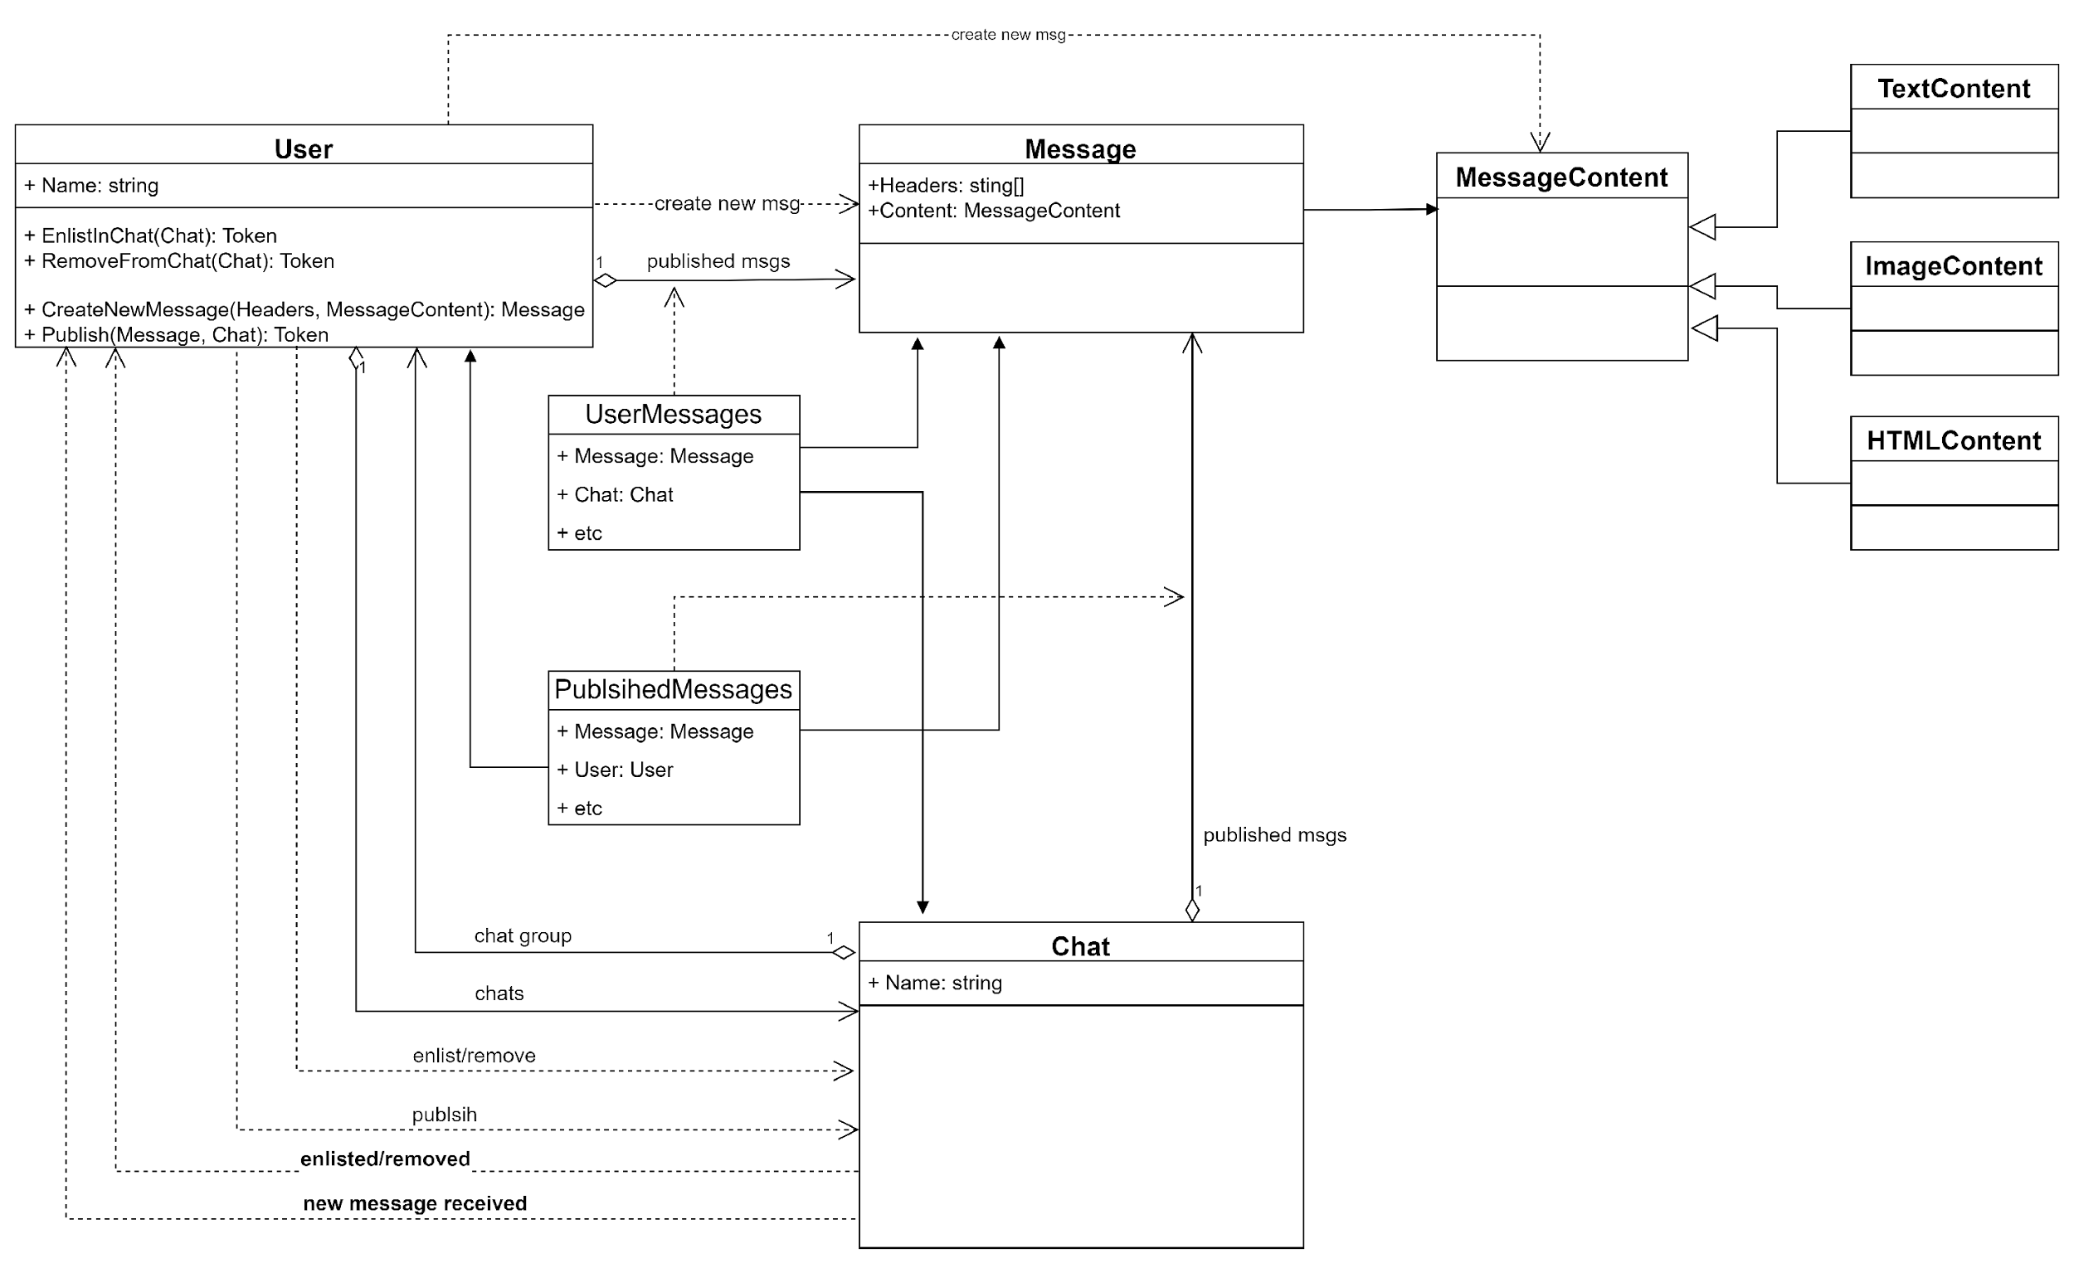
Domain Model Class Diagram

Slide 12

Implementation review
OOP - Classes - Inheritance - Polymorphism - Louse-coupling SOLID - Single Responsibility - Open for extension, closed for modification - Every derived class should be substitutable for its parent class (Liskov Principle) - Interface segregation - Depend on abstractions, not on concretions. - Details should depend upon abstractions
Notes:
Classes – Message.cs, User.cs, AbstractClient.cs, AbstractServe.cs
Inheritance – Message.cs, User.cs
Polymorphism - Message.cs, User.cs
Louse-coupling – Message.cs, User.cs, AbstractClient.cs, AbstractServe.cs
Single Responsibility – User.cs – rows 56, 66 | Client.cs – rows 32, 46
Open/Closed principle – Message.cs, User.cs, AbstractServer.cs, AbstractClient.cs
Liskov Substitution same as Open/Closed principle
Interface segregation – AbstractServer, AbstractClient
Dependency inversion - Message.cs, User.cs, AbstractClient.cs, AbstractServe.cs

Slide 13
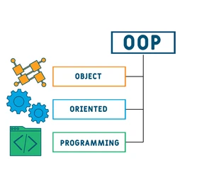
Some conclusions
OOP is still alive ☺ It is well suited for Domain Driven Design Functional paradigm makes an impact

Slide 14

OOP what's next?
Future is coming…

